Slide 1
NAAN MUDHALVAN
SPEAR PHISHING
Z.Sameer Ahmed
Aalim muhammed salegh college of engineering
Computer Science And Engineering

Slide 2
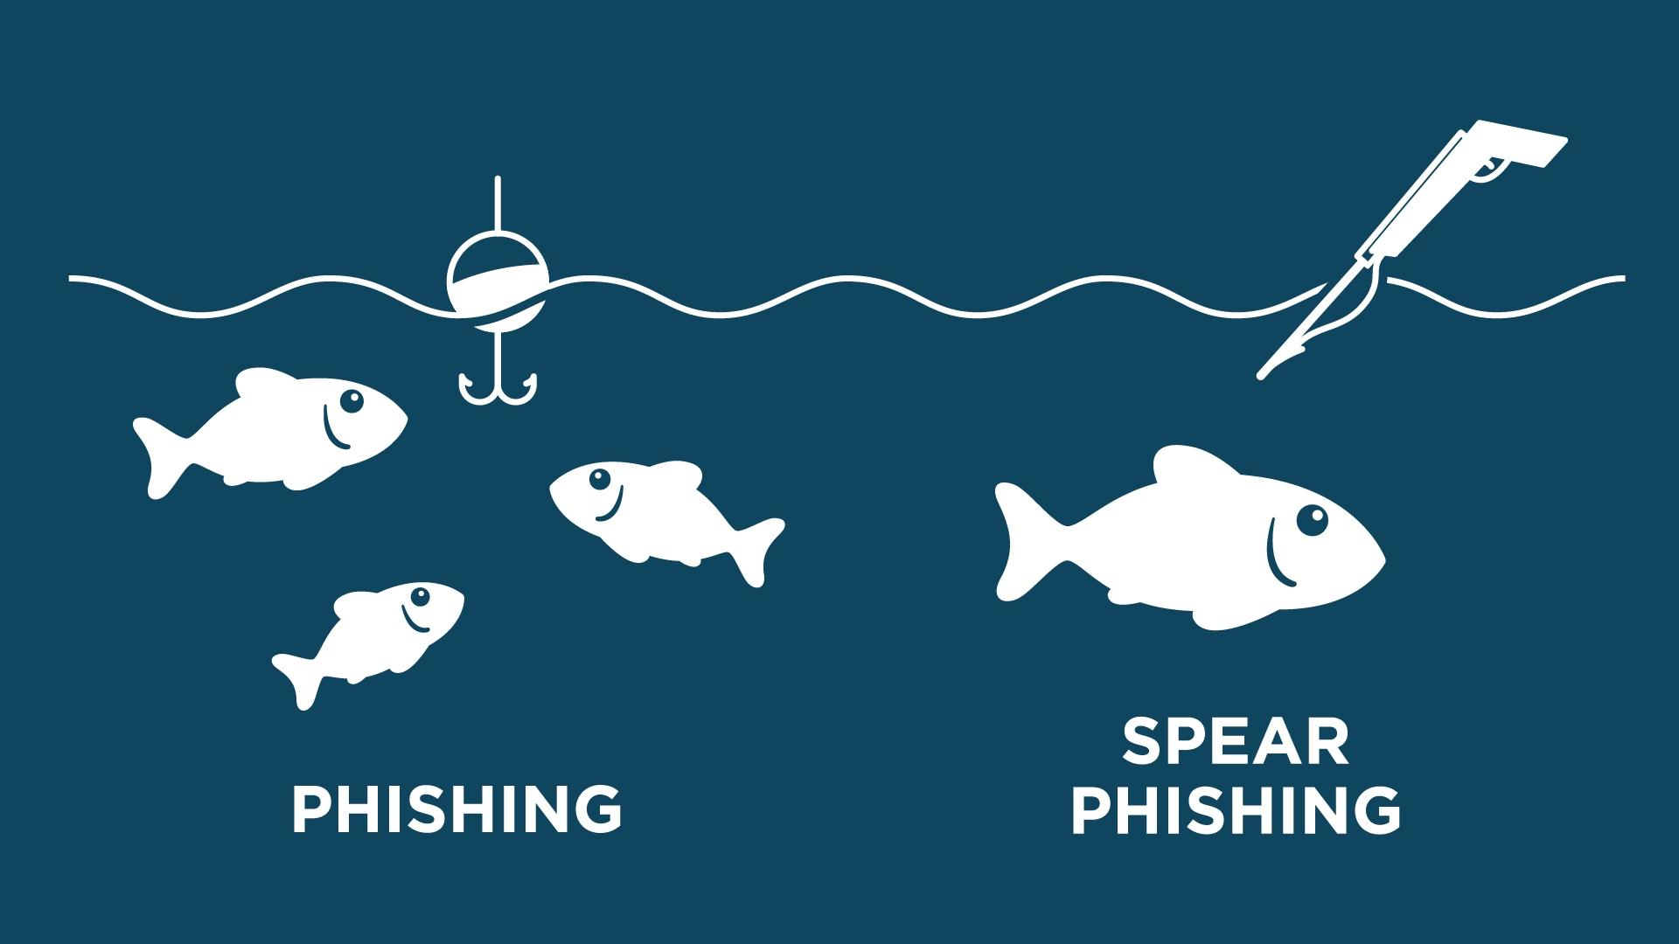
Introduction to Spear Phishing
Spear phishing is a sophisticated form of cyber attack that targets specific individuals or organizations. It involves crafting highly personalized emails to lure victims into revealing sensitive information or installing malware on their devices.

Slide 3
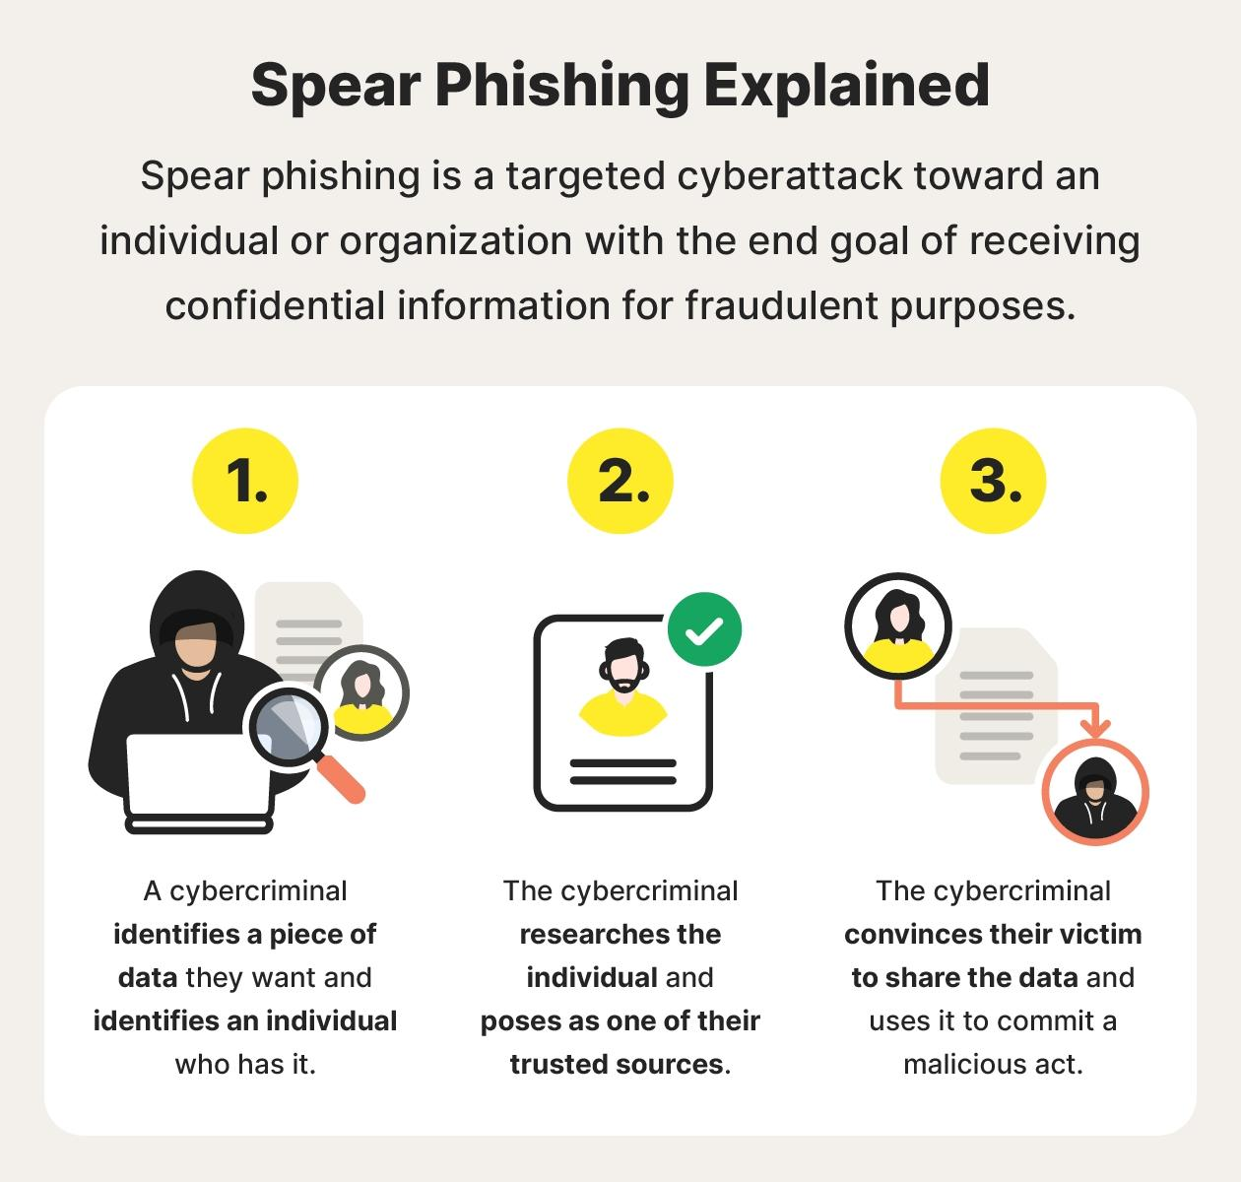
What is Spear Phishing?
Spear phishing is a targeted cyber attack that uses deceptive emails or messages to trick individuals into revealing sensitive information or performing harmful actions. Unlike mass phishing, spear phishing campaigns are highly personalized and tailored to specific victims.
Spear phishers often impersonate trusted figures or organizations to gain the victim's trust, making the attacks harder to detect and more effective.

Slide 4

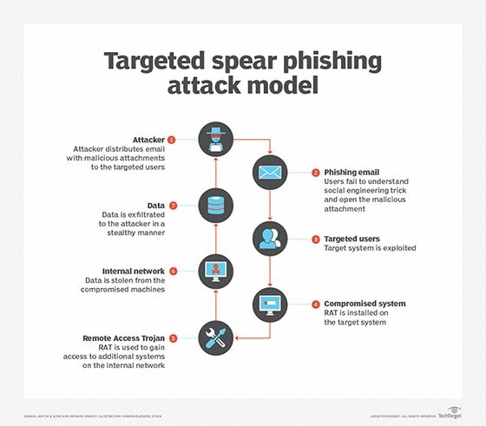
Problem Statement
Spear phishing attacks have become a major threat to organizations, resulting in significant financial and reputational damage. These targeted attacks exploit human vulnerability by sending personalized emails that appear to be from a trusted source, tricking users into revealing sensitive information or executing malicious code.
The key challenge is to protect against these sophisticated and constantly evolving phishing tactics that bypass traditional security measures. A comprehensive solution is needed to enhance user awareness, detect and prevent spear phishing attempts, and mitigate the impact of successful attacks.

Slide 5

Project Overview
Understanding the Problem
1
Spear phishing is a type of targeted cyberattack that aims to steal sensitive information or gain unauthorized access to systems. Our project aims to develop a comprehensive solution to mitigate this growing threat.
2
Defining Objectives
The key objectives of this project are to detect and prevent spear phishing attacks, educate end-users on spotting suspicious activities, and provide businesses with the tools and strategies to bolster their cybersecurity defenses.
Scope and Deliverables
3
This project will encompass the design and implementation of an AI-powered spear phishing detection system, the creation of a user-friendly awareness and training program, and the delivery of a comprehensive cybersecurity framework for our clients.

Slide 6
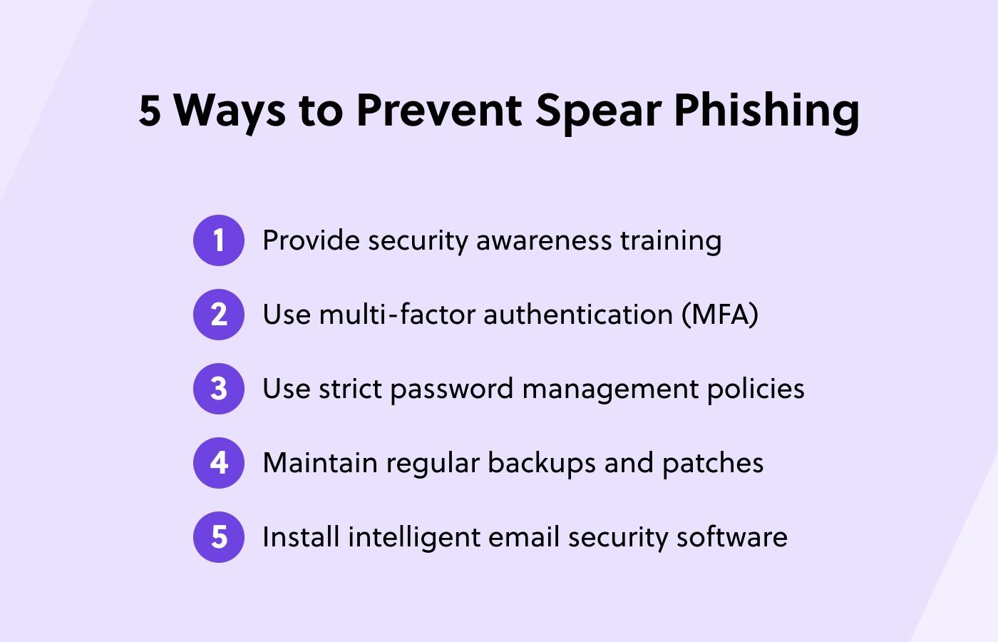
Proposed Solution
Our proposed solution leverages advanced machine learning algorithms to detect and mitigate spear phishing attacks. By analyzing email content, sender behavior, and network activity, we can identify suspicious activity and alert users in real-time.
The solution integrates seamlessly with existing email and security infrastructure, providing a comprehensive defense against targeted phishing threats.

Slide 7
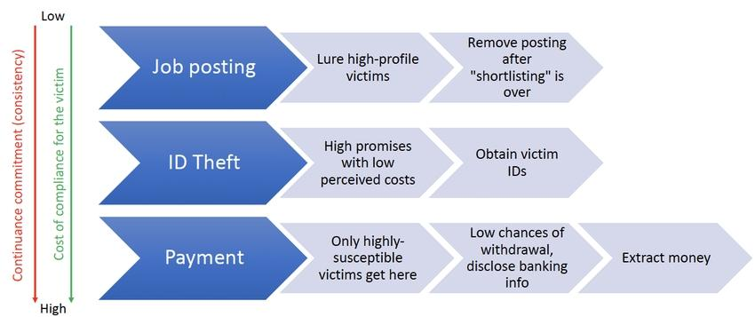
System Approach
Our system approach to addressing spear phishing involves a multi-layered defense strategy. We utilize advanced machine learning algorithms to continuously monitor and analyze network traffic, user behaviors, and email content for suspicious activities.
Implement robust email filtering and threat detection capabilities to identify and block malicious messages.
Leverage user behavior analytics to detect anomalies and potential phishing attempts in real-time.
Provide comprehensive employee training on recognizing and reporting phishing scams, promoting a culture of cybersecurity awareness.

Slide 8

Algorithms and Deployment
Algorithmic Approach
Cloud-based Deployment
Continuous Monitoring
Our spear phishing detection algorithm leverages machine learning techniques to analyze email content, sender information, and user behavior patterns to identify suspicious activity.
The solution is deployed in the cloud, allowing for scalable processing power and seamless updates to stay ahead of evolving threat landscapes.
Real-time monitoring and threat intelligence ensure the system adapts quickly to new phishing tactics, providing robust protection for your organization.

Slide 9
Who are the end users?
1
Cybersecurity Professionals
2
IT Administrators
Cybersecurity experts who need to detect, prevent, and respond to spear phishing attacks.
IT personnel responsible for securing company networks and educating employees about phishing threats.
3
Business Leaders
4
Everyday Employees
Executives and managers who need to understand the risks of spear phishing and implement effective countermeasures.
Regular office workers who must be trained to recognize and report suspicious emails and messages.

Slide 10
Agenda
Welcome
Problem Overview
Proposed Solution
Q&A
We'll begin with a warm welcome and introduction to the topic of spear phishing.
We'll open the floor to questions and feedback from the audience.
We'll discuss the growing threat of spear phishing attacks and their impact on individuals and organizations.
Our team will present a comprehensive solution to detect and prevent spear phishing attacks.

Slide 11



Future Scope
Improved detection
1
Refine algorithms to catch more advanced phishing attacks
2
Real-time monitoring
Enable live surveillance of user activities
Automated response
3
Rapidly quarantine threats and notify administrators
Looking ahead, our spear phishing solution aims to continually enhance its detection capabilities, enabling it to catch even the most sophisticated phishing attempts. We also envision integrating real-time monitoring to provide proactive defense, as well as automatic response mechanisms to quickly isolate and mitigate threats.
Cybersecurity professionals require robust tools to analyze and mitigate spear phishing threats effectively.
IT administrators need comprehensive solutions to secure company networks and educate employees about phishing threats.
Business leaders seek to understand and implement effective countermeasures against spear phishing.
Everyday employees require training to recognize and report suspicious emails and messages.

Slide 12
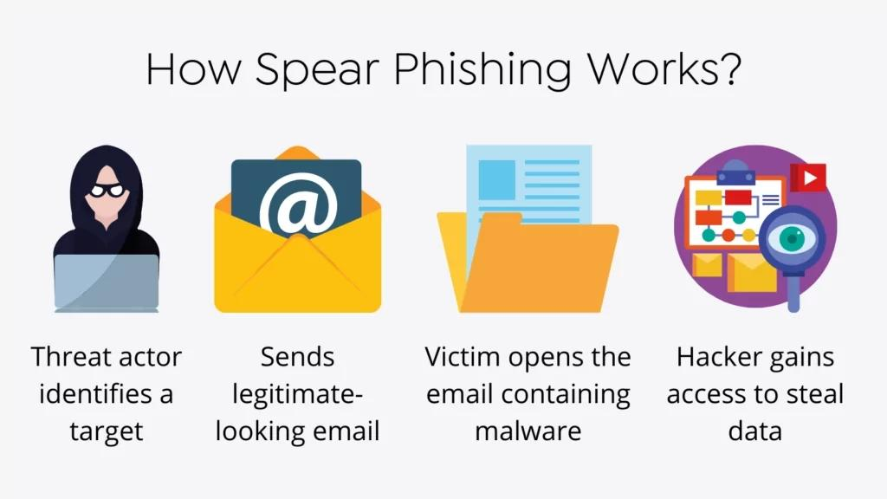
RESULT
Our spear phishing solution will utilize advanced machine learning algorithms for real-time detection.
The deployment will be seamless, with minimal disruption to existing network operations.
We'll also implement automated response mechanisms to swiftly neutralize threats.
This proactive approach will ensure maximum protection for our end users.

Slide 13
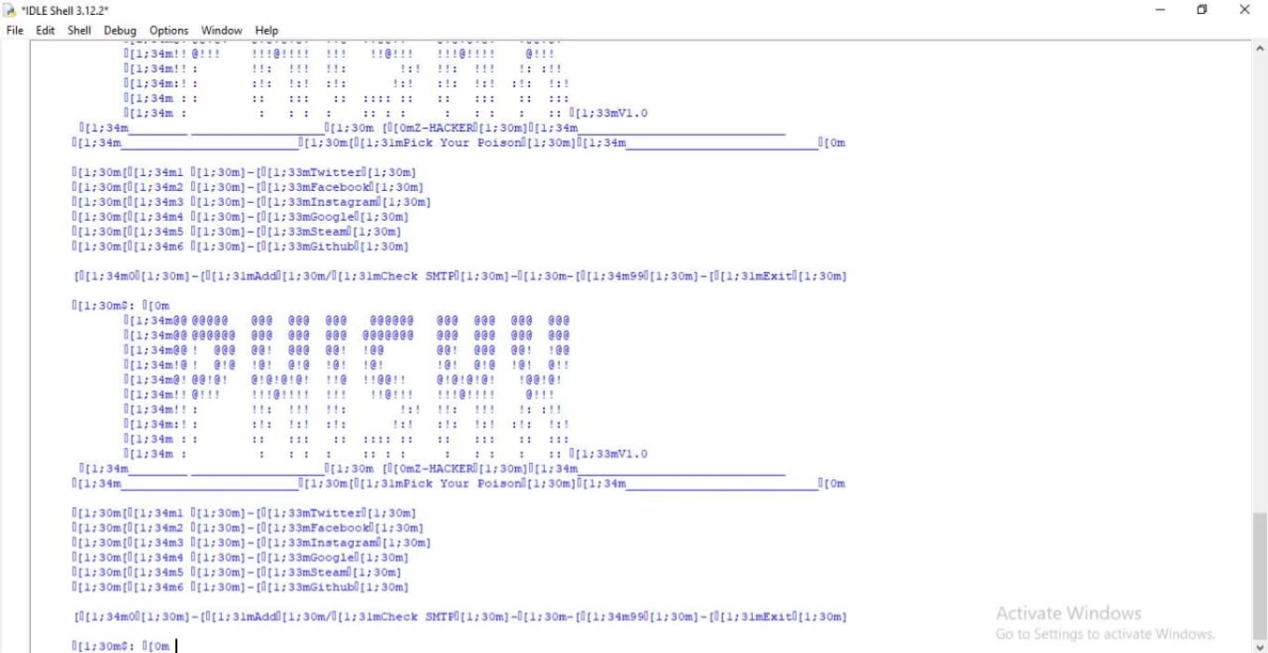
Output

Slide 14
THANK YOU

